Slide 1
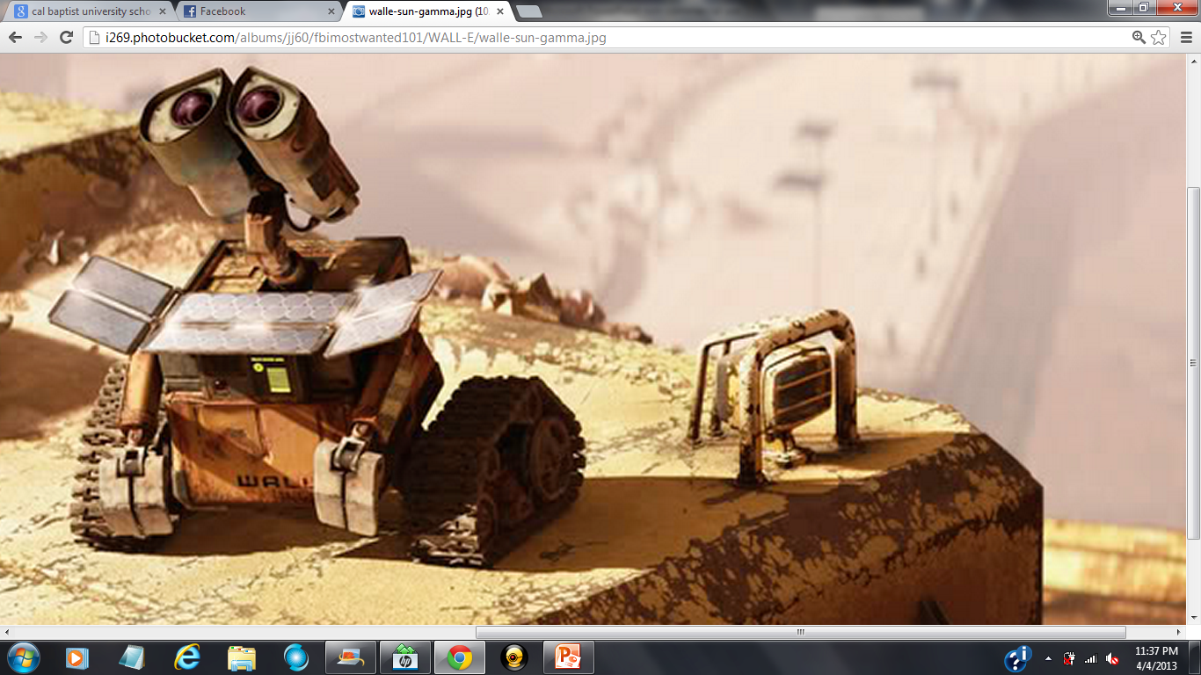
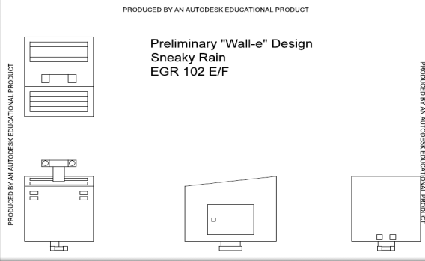
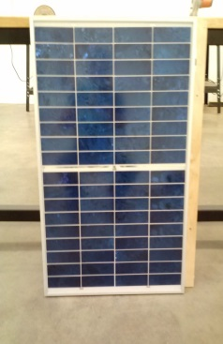

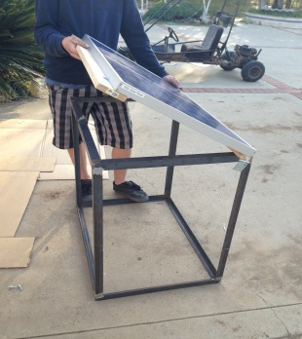
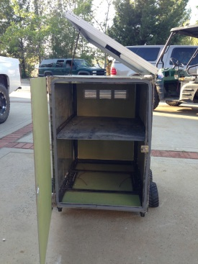
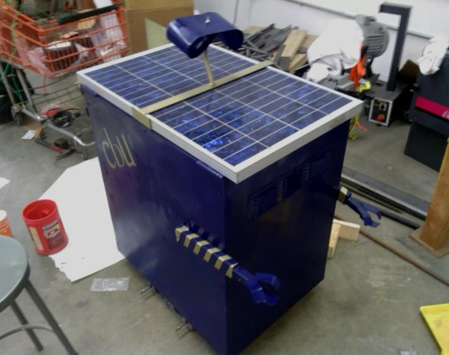
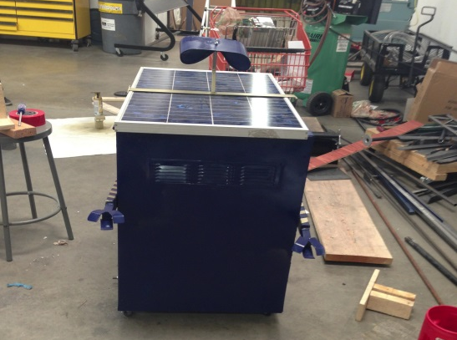
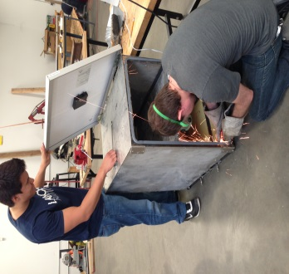

Mobile Solar Power Station
Our initial design on the AutoCAD drawing software
Our solar panel is capable of producing 50 V of Direct Current, 1000 W/m², and has an amperage of 1.5.
Our solar power station has a 12 V output which charges common electronic devices
The frame measured to hold our solar panel by Daniel Lombardo
The initial base structure without electrical components
Jordan Rainy filing down screws while Joshua Hanson checks out the solar panel
Side view of the “Wall-E” solar station
Front view of the “Wall-E” solar station
By: Sneaky Rain: Jordan Rainy: Team Leader, Jordan Ziegler: Secretary, Daniel Lombardo: Communication’s Officer, Rocky DeLyon: Utility, Joshua Hanson: Utility
Special Thanks To: CBU: College of Engineering,
Dr. Donaldson: Dean of Engineering,
Dr. Chun: Client

